Slide 1

NGAVAX
By David Daniels,
Dante Zorrilla,
& Kamden Burke

Slide 2
Nginx Background
NGINX is a free, open-source, high-performance HTTP server and reverse proxy.
NGINX is used for web serving, reverse proxying, caching, load balancing, media streaming, and more. It started out as a web server designed for maximum performance and stability.
NGINX is known for its high performance, stability, rich feature set, simple configuration, and low resource consumption.
It’s creation to solve the C10K problem, a term coined in 1999 to describe the difficulty that existing web servers experienced in handling large numbers (the 10K) of concurrent connections.

Slide 3
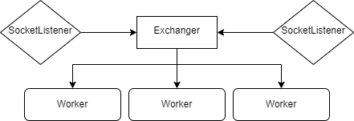
Multi-threaded workload
For each port, a new thread is spawned, such that they don’t block each other.
Anytime something is written to the exchanger, the worker must finish loading before something can be written again.
Workers are spawned based on the specified amount in the configuration file.

Slide 4
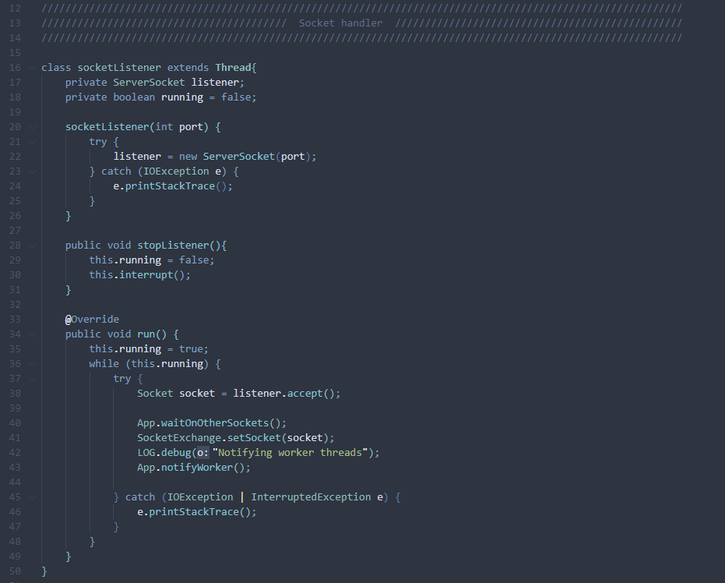
Multi-threaded workload
This is the socketListener. A thread is spawned for each one that is needed.
The thread is simple and once started it will be waiting for a request. Once a request comes in, it will “wait” on the SocketExchange to be made available for writing.
Then it will “release” a worker thread and resume waiting for a request.

Slide 5
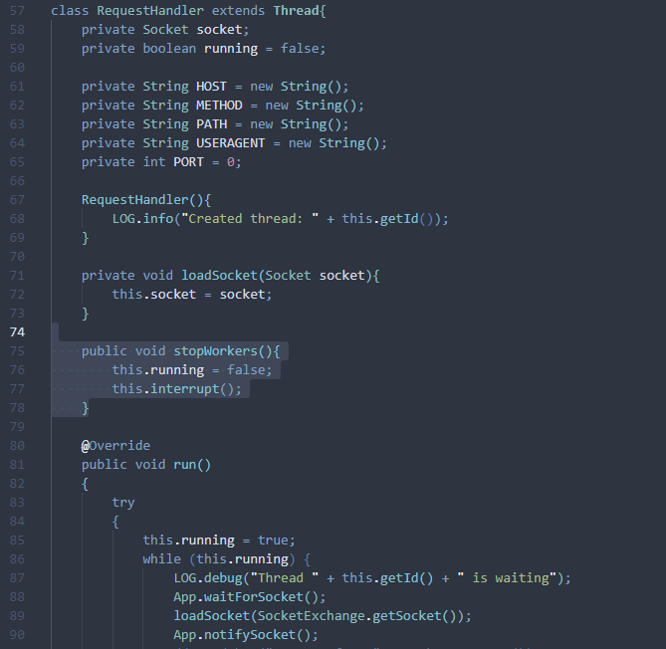
Multi-threaded workload
The worker thread is relatively simple.
It spawns and immediately enters a while loop and waits for the SocketListener to notify it to begin.
Once notified, it loads the shared object and then notifies the socket that it is done.
From there it begins to fulfill the request

Slide 6
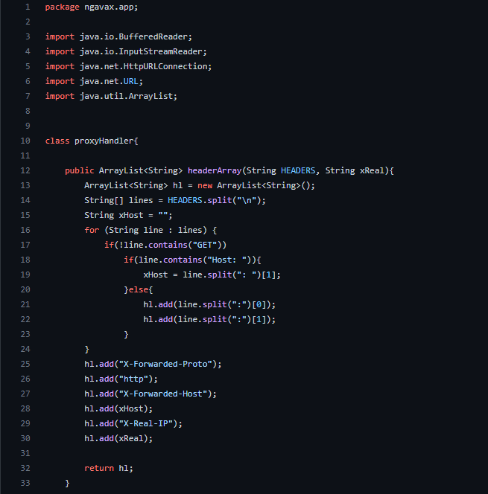
HTTP Proxy
headerArray
Takes in Client’s headers and converts it into a string array. The list is separated by new line, which then loops over the array. It ignores certain headers.
Forwarded - Proto is used as a de-facto standard header for identifying the protocol (HTTP or HTTPS) that a client used to connect to your proxy or load balancer.
The X-Forwarded-Host (XFH) header is a de-facto standard header for identifying the original host requested by the client in the Host HTTP request header.
X- Real- IP provides the client’s IP address

Slide 7
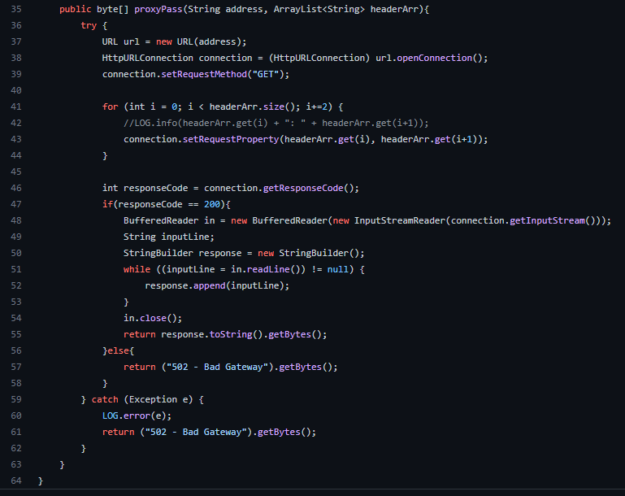
HTTP Proxy
proxyPass
proxyPass takes in the Array from headerarray and creates to a url address and url connection. There is a for loop that adds the headers to the request.
If there is a OK response (200), it will output the response.
If there is no response or outputs another error code, it will default to error 502, with a catch so the code will output the error message.

Slide 8
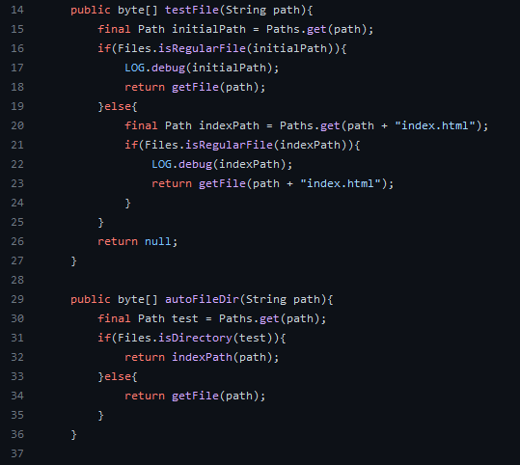
Serving Static Files
Static content is any content that can be delivered to an end user without having to be generated, modified, or processed. The server delivers the same file to each user, making static content one of the simplest and most efficient content types to transmit over the Internet.
testIndex: To serve static files with nginx, we reference the static file entry point as the index file, read the contents of the file into a byte array, and then closes the file. For unavailable files, nginx responds with the 404 HTTP status code.
autoFileDir: Makes sure we return byte array for directories and path for files.

Slide 9
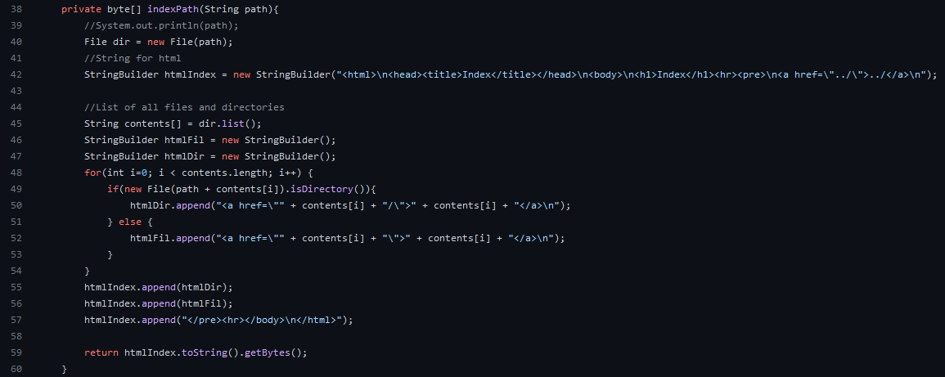
Autoindex: indexPath
Auto Indexing will be done by having a generated HTML file with all the files in a specified directory.
Depending if the path is from a file or directory we’ll append it to the html index, and return as a byte array.

Slide 10
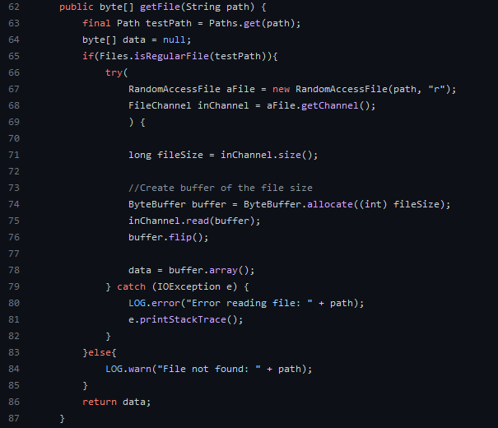
Autoindex: getFile
RandomAccessFile provides the facility to read and write data to a file.
We create a channel for reading, writing, mapping, and manipulating a file in order to get the size and read the contents of the file and return a byte array of the content.
For unavailable files, nginx responds with the 404 HTTP status code.

Slide 11
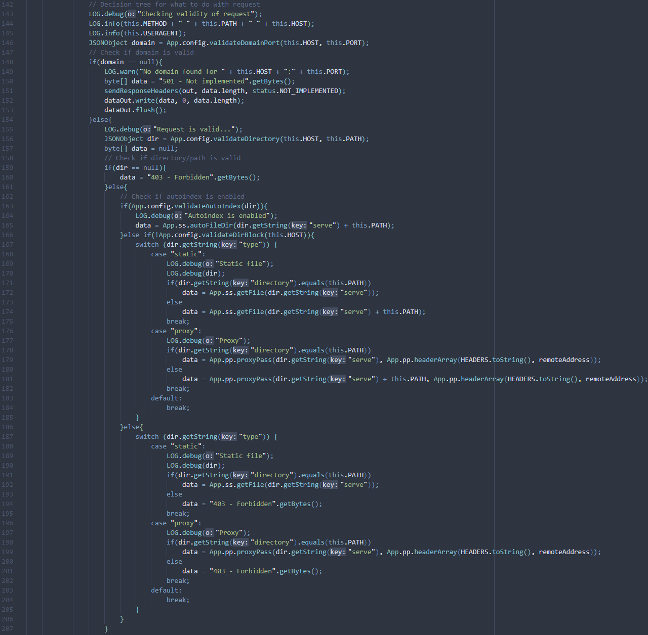
Request Handler
The request handler is where the logic behind what is served is handled.
It starts out by checking if the domain is in the config, then it checks the path and various methods associated with it.
Finally it creates a response based on the request HEADERS received.

Slide 12
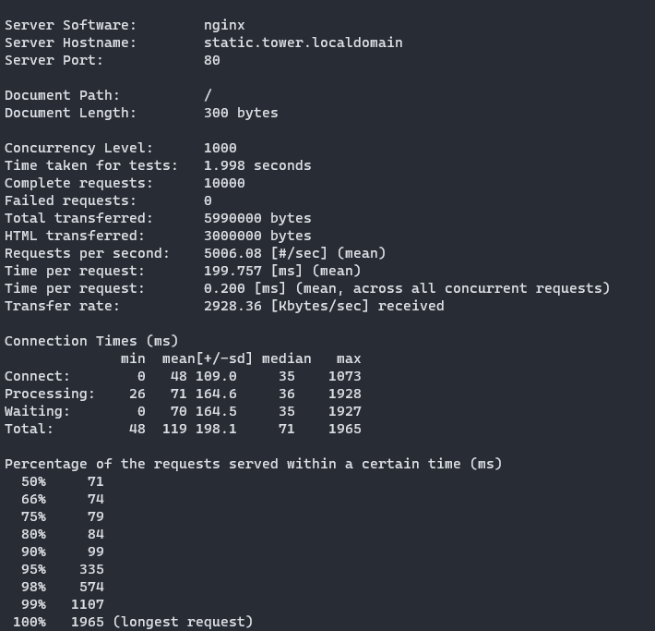
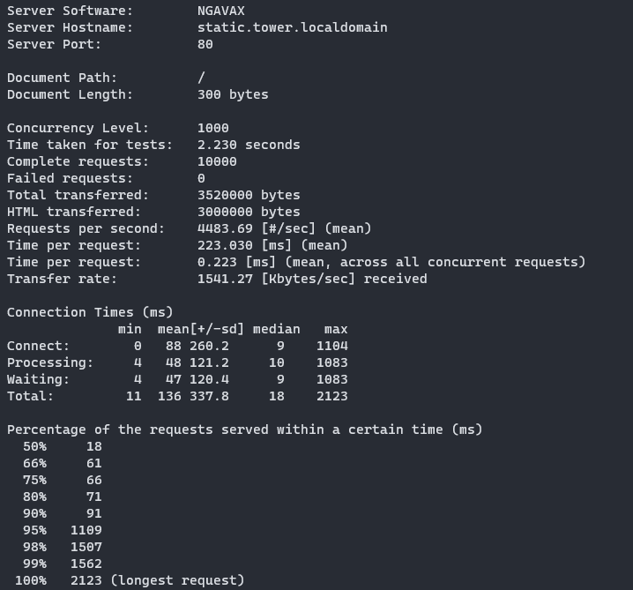
Some benchmarks to compare to nginx

Slide 13
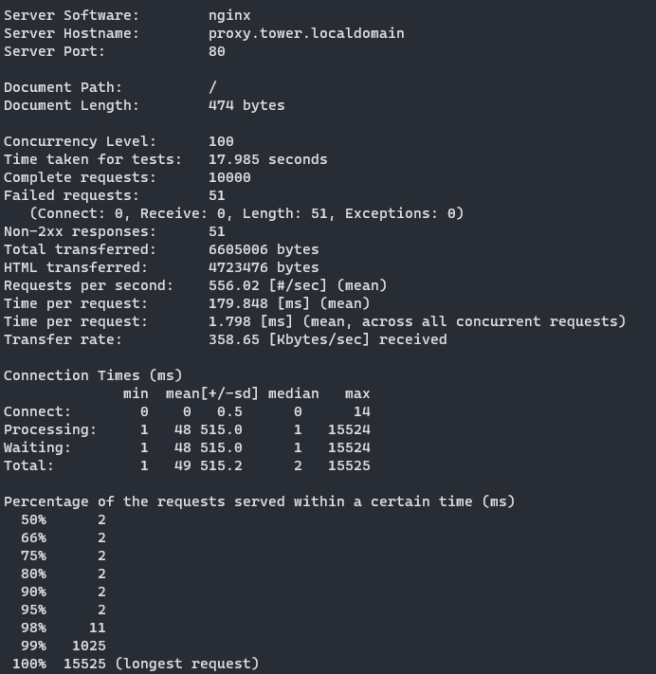

Some benchmarks to compare to nginx

